Slide 1
Assignment 10 Screenshots
The migraine edition!
Katie Hawthorne

Slide 2
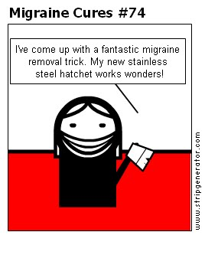

Slide 3
Package Organization
Packages
Generics (generic collections)
Avatars (composed graphics)
Composition (scenes)
Scenery (contains the bridge stuff)
Graphics (lines, text labels, etc.)
Main
Scanner (scanner/parser related stuff)
Chat (chat history composed stuff)

Slide 4
Files Edited
Generics package
GenericCollection
GenericCollectable
TalkingScene
TokenScanner
Parser
TokenHistory
Chat History
Also, my composed vs. atomic shapes were already in separate packages…

Slide 5
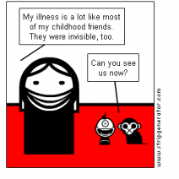

Slide 6
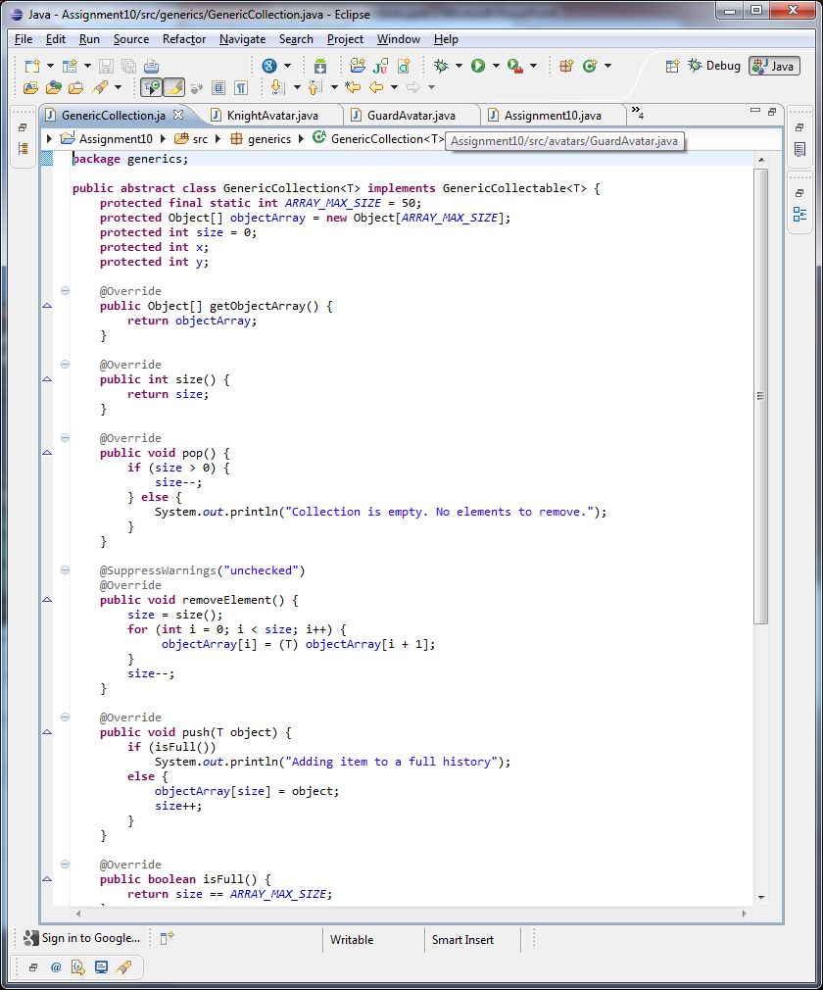
Generic Collection

Slide 7
Implemented Generic Collections
public class TokenHistory extends generics.GenericCollection<Token> implements Historical, generics.GenericCollectable<Token> {
TokenHistory
ChatHistory
public abstract class ChatHistory extends generics.GenericCollection<Label>
implements History, generics.GenericCollectable<Label> {

Slide 8
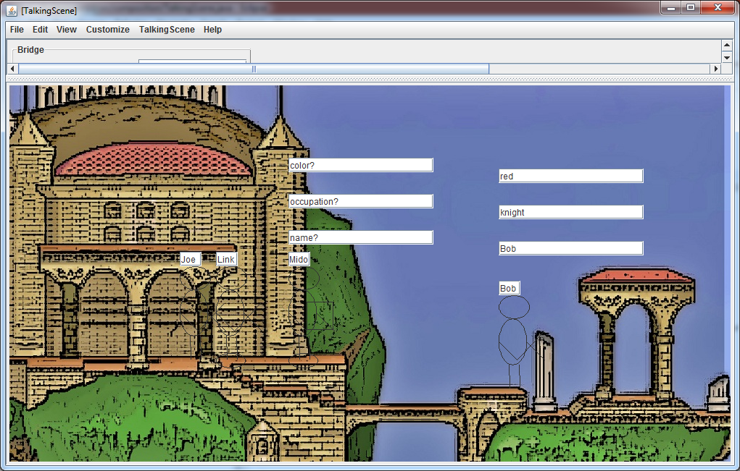
Approaching knight must be "passed" before crossing the bridge

Slide 9
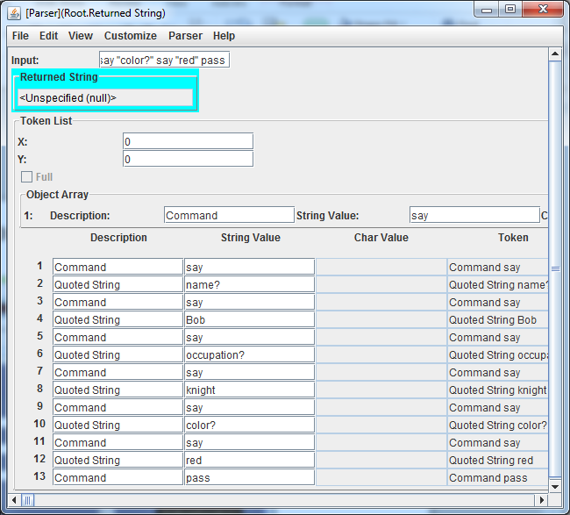

Slide 10
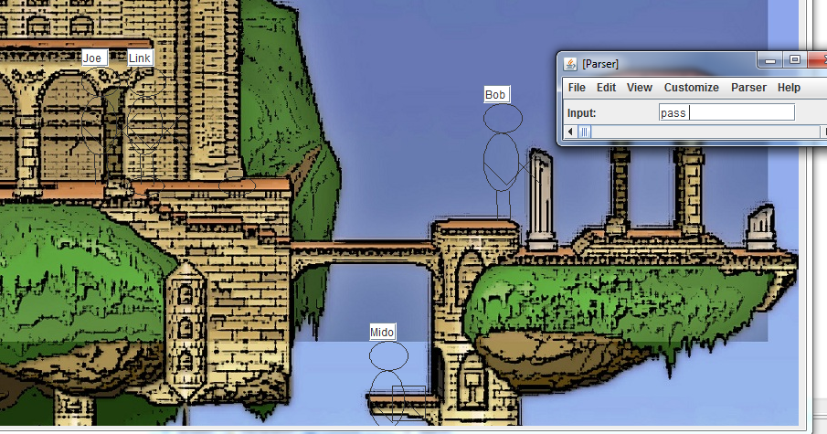
Approaching knight can pass if guard failed (note: currently my parser only recognizes and fails the knight. The guard must be failed from the scene functions).

Slide 11
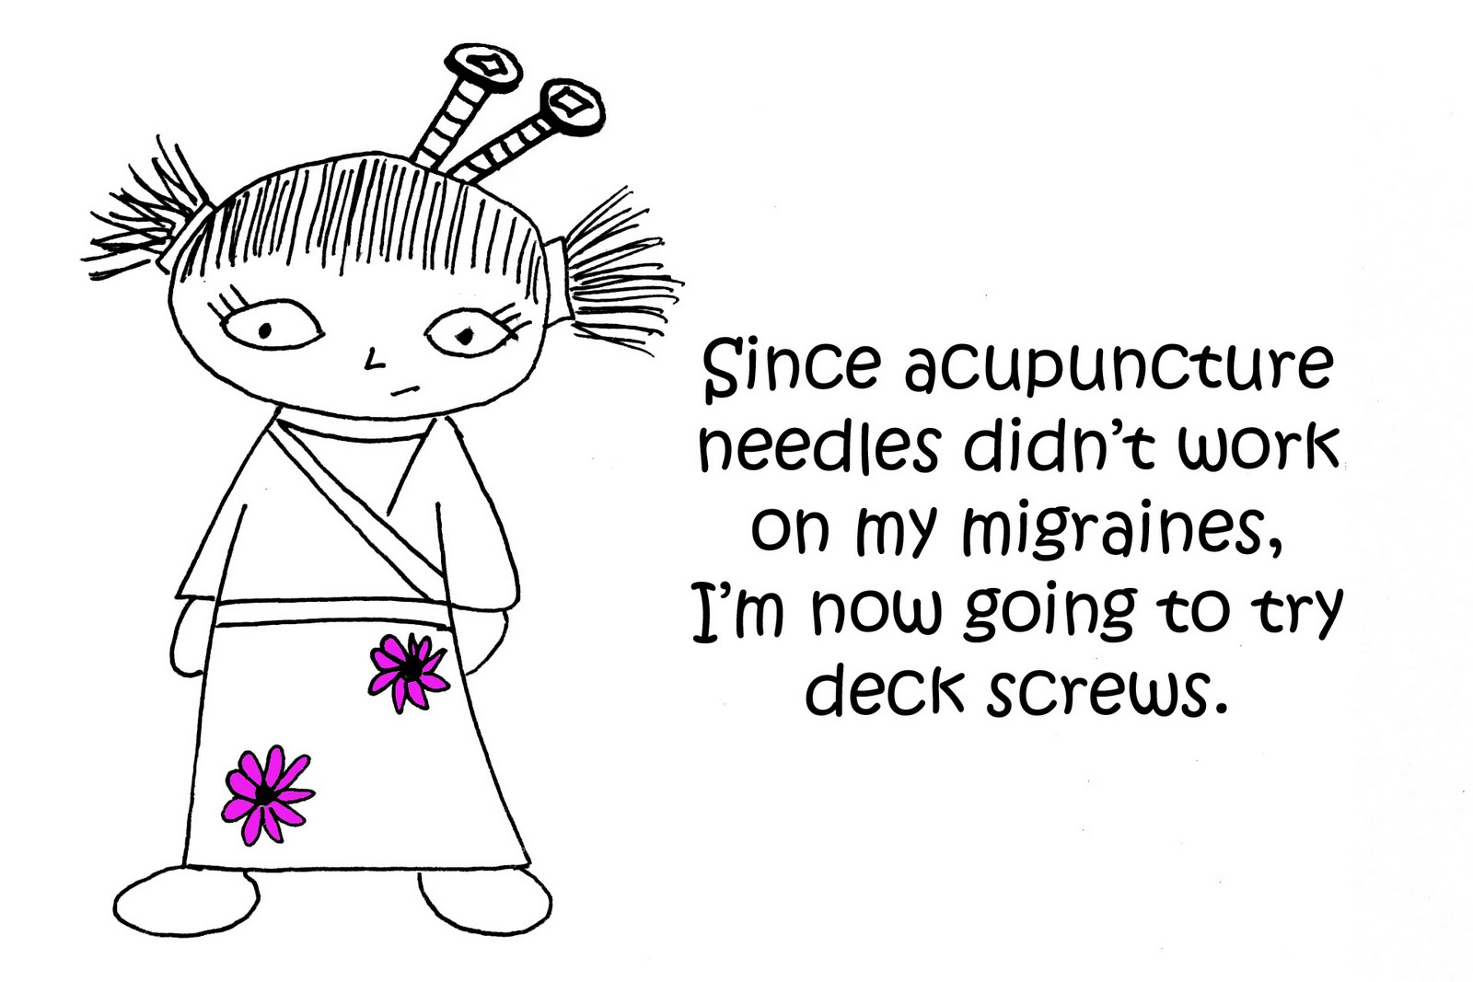

Slide 12
Approaching knight can pass if has answered N = 3 questions

Slide 13
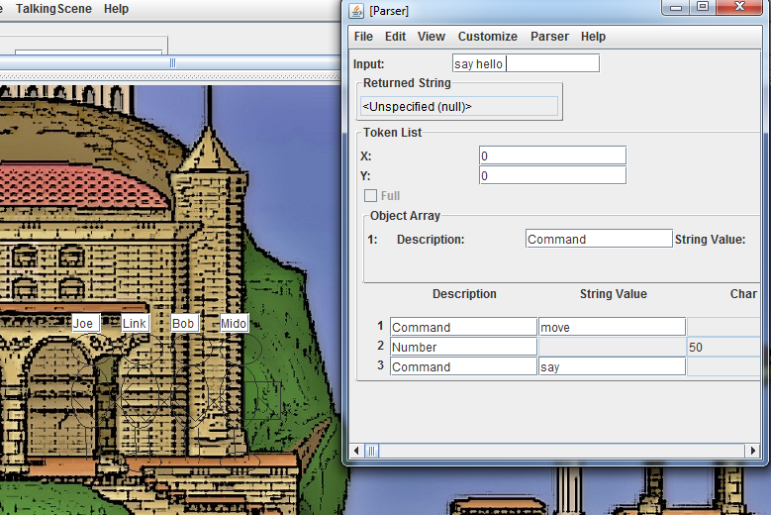
Say Command has no effect if knight not in standing area

Slide 14
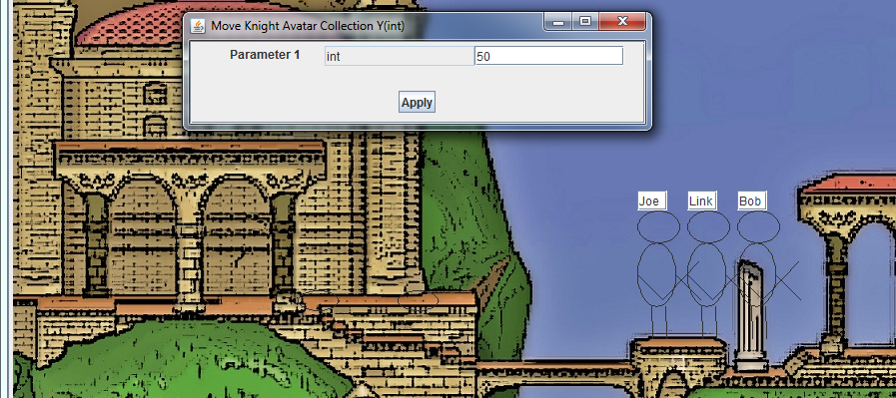
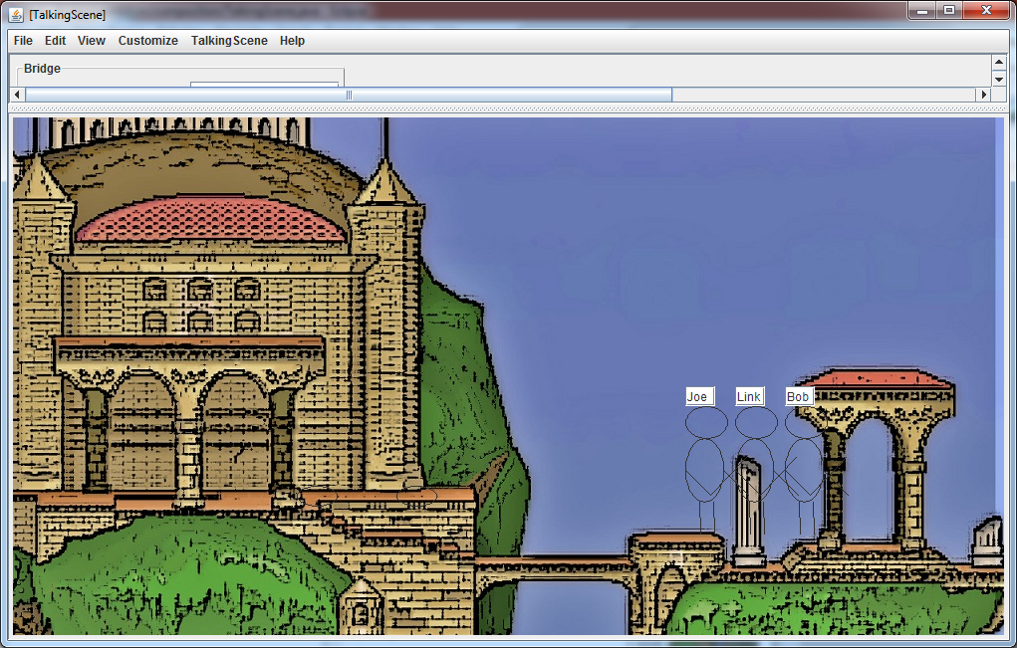
Move affects departing knights only if list of approaching knights is empty

Slide 15

And since we could all use some cheering up….

Slide 16
Extra Credit: Submitting Early I got sick of looking at my code and did not implement abstract methods. I’m very sorry. I’m sure you’re crushed that you have less to grade. Do not fear, however, because later once I know how to document it, you’ll be regrading everything I messed up before! Muahahaha….haha…ha.. ha?

